Slide 1

The Comprehensive Evaluation of Students with Complex Profiles
The Why, How, and What’s Next of Student Evaluation
Richard R. Reid PhD

Slide 2

Introductions
Notes:
In psychologist school you do not learn about low incidence populations; Five-year internship at the UVM Center for Dev Dis

Slide 3
The Most Important Question of the Day
Why do we assess our students?
What challenges have you faced?

Slide 4
Why do we test our students?
To determine initial or continued edibility for services
To be in compliance with Vermont and Federal regulations
To identify potential strengths and challenges
To inform instruction and program development
To inform IEP development
Gather information related to enabling involvement and progress within the general education curriculum
To document growth
Accountability

Slide 5
However
2362.2.3 Re-Evaluation Requirements (34 CFR §300.303)
The LEA shall ensure that a reevaluation of each child with a disability is conducted:
If the LEA determines that the educational or related service needs, including improved academic achievement and functional performance, of the child warrant a reevaluation; or
(2) If the child’s parent or teacher requests a reevaluation.
(b) A reevaluation conducted under sub-section (a):
May occur not more than once a year, unless the parent and the LEA agree otherwise; and
(2) Shall occur at least once every 3 years, unless the parent and the LEA agree that a reevaluation is unnecessary.

Slide 6
Who conducts the comprehensive evaluation ?
The Educational Planning Team (EPT):
A local education agency (LEA) representative;
At least one special education teacher of the student/child, or if appropriate, at least one special education service provider for the student/child;
At least one general education teacher of the student/child, to the extent appropriate, if the student/child is, or may be, participating in the general education environment; The student when his or her post-secondary transition needs or services will be considered and other agencies likely to be responsible for providing or paying for transition services;
At the discretion of the parent or the school district, other individuals who, in the opinion of the parents or school district; have knowledge or special expertise regarding the student/child, including related services personnel, as appropriate;
An individual who can interpret the instructional implication of evaluation results, who also may be a member of the team as described in sections (1), (2), (3) and (5) above;
The parent(s), guardian or educational surrogate parent of the student/child who shall be given meaningful opportunity to contribute information to the development of an evaluation plan, and
If appropriate, the student/child.

Slide 7
“Students with Complex Profiles”
Who Are We Talking About?
Students with complex profiles (AKA, low incidence population students)
Autism Spectrum Disorder
Deaf-blindness
Hearing Loss
Intellectual disability
Multiple disabilities
Orthopedic impairment
Other health impairment
Traumatic brain injury

Slide 8

However…
With the changing landscape of Learning Disability identification regulations (e.g., Response to Intervention, Patterns of Strength and Weakness) the breadth of our persons of interest has expanded dramatically

Slide 9
What do we assess
Physical Characteristics:
Vision
Hearing
Health
Medical
Nutrition
Adaptive Behavior Across Settings:
Independence skills
Coping skills
Self-care skills
Assistive Technology Needs
Social, behavioral, or emotional characteristics:
Self-esteem
Self-control
Interaction with peers and adult
Speech characteristics:
Articulation
Fluency
Voice
Language and Communication Skills
Vocational Needs
Skills in the Learning Environment

Slide 10
What do we assess
Relevant Life Circumstances:
Family
Community
Environmental Factors
Intellectual or Cognitive Characteristics:
Learning Abilities
Cognitive strengths
Reasoning
Basic Skill Areas:
Oral expression
Listening comprehension
Written expression
Basic reading skills
Reading comprehension
Mathematics calculation
Mathematics reasoning
Motor skills

Slide 11
Assess With What ?
(4) Ensure that assessments and other evaluation materials used to assess a child are:
(vii) Selected and administered so as best to ensure that if an assessment is administered to a child with impaired sensory, manual, or speaking skills, the assessment results accurately reflect the child’s aptitude or achievement level or whatever other factors the test purports to measure, rather than reflecting the child’s impaired sensory, manual, or speaking skills (unless those skills are the factors that the test purports to measure)
(vi) Those tailored to assess specific areas of educational need and not merely those that are designed to provide a single general intelligence quotient.
(7) Ensure that assessment tools and strategies provide relevant information to directly assist the IEP team in determining that the educational needs of the child are provided.

Slide 12
How do we do it
(b) In conducting the evaluation, the LEA shall:
(1) Use a variety of assessment tools and strategies to gather relevant functional, developmental, and academic information about the child, including information provided by the parent…
What is an Assessment Tool or Strategy
Any sample of a student’s behavior: Standardized and/or Student Centered (AKA, “Informal”)

Slide 13
Various Types of Assessments
Standardized Assessment
Norm-Referenced
Criterion Referenced
Curriculum Based Assessment
Curriculum Based Measurement
Ecological Assessment
Error Analysis
Dynamic Assessment
Checklists
Rating Scales
Student Centered
Observations

Slide 14
Factors Affecting Accurate Assessment
Ability of participant to understand the assessment stimuli
Ability of participant to respond to the assessment stimuli
Appropriate normative comparisons
Appropriateness of the level of the items
Exposure to the material being assessed
Relationship with the evaluator
Participant related variables
Evaluator related variables
Environment

Slide 15
Evaluation Results/Reports are only as good as the questions asked by the Educational Planning Team (EPT)
You are the consumer! Be sure that contracted professionals clearly answer your evaluation questions. If they do not, feel comfortable in asking the evaluator to do so.
If evaluation results raise new questions, be comfortable in following up by asking additional questions.

Slide 16
Evaluation Results/Reports are only as good as the questions asked by the Educational Planning Team (EPT)
“What is Elwood's current level of cognitive ability?”
“What are the relative strengths and challenges within Elwood’s cognitive profile?
“What does Elwood’s cognitive profile tell us about potential instructional strategies and approaches?”
“What is Elwood's current level of adaptive behavior?”
“What are Elwood’s relative strengths and challenges within the adaptive behavior domains?”

Slide 17
Some Psychometrics to Help Understand Assessment Results
Reliability – consistency of and confidence in test results
Validity – does the test measure what it purports to measure; is it something important to the student of focus
Standard Deviation
Standard Error of Measurement
Meaning of various scores

Slide 18
Types of Reliability
Type | Description
Test-Retest | Test produces similar results when given at two points in time
Alternate Form | Two versions of the same test produce similar results
Internal | Different parts of the same test produce similar results
Inter-rater (or inter-scorer) | Two or more raters who administer and score a test come to similar conclusions

Slide 19
Types of Validity
Type | Description
Face | Test appears to measure what it is supposed to measure
Content | Test assesses all important aspects of phenomenon
Concurrent | Test yields the same results as other measures of the same behavior
Predictive | Test predicts the behavior it is supposed to measure
Construct | Test measures what it is supposed to measure and not something else

Slide 20
Standard Error of Measurement (SEM)
The error associated with a single score
Used to construct Confidence Intervals
Mandated use in reporting out results
For example:
  SEM = 3
  Obtained Score = 72
  Confidence Interval (band) = Obtained score + and – the SEM Confidence Band = 69 – 75
  When would this be important?

Slide 21
Intellectual Disability VT Dept. of Ed Rules & Regulations
(e) Intellectual disability means a delay in learning of sufficient magnitude to cause a student's performance to fall at or below -1.5 standard deviations from the mean of a test of intellectual ability, existing concurrently with deficits in adaptive behavior.

Slide 22
Intellectual Disability – VT Dept. of Disabilities, Aging, and Independent Living
(a) “Intellectual disability” means significantly sub-average cognitive functioning that is at least two standard deviations below the mean for a similar age normative comparison group. On most tests, this is documented by a full scale score of 70 or below on an appropriate norm-referenced standardized test of intelligence and resulting in significant deficits in adaptive behavior manifested before age 18.
(b) The most universally used standardized intelligence test for school-aged children up to age 16 is the Wechsler Intelligence Scale for Children (WISC), current edition. The most universally used measure for children over age 16 and adults is the Wechsler Adult Intelligence Scale (WAIS), current edition. For people with language, motor, or hearing disabilities, a combination of assessment methods shall be used and the psychologist shall use clinical judgment to determine the best tests to use for the individual. Diagnosis based on interpretation of test results takes into account a standard error of measurement for the test used
Beware Regulatory Myth

Slide 23
Standard Error of Measurement (SEM)
The error associated with a single score
Used to construct Confidence Intervals
Mandated use in reporting out results
For example:
  SEM = 3
  Obtained Score = 72
  Confidence Interval (band) = Obtained score + and – the SEM = 69 – 75

Slide 24
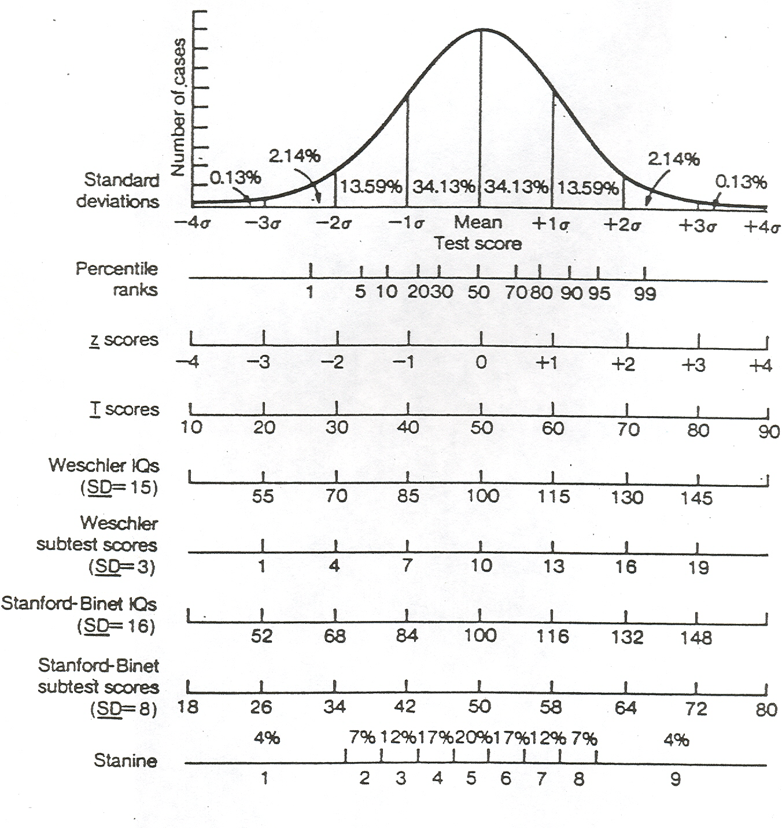
Elwood’s Adaptive Behavior Composite score
Elwood obtained an Adaptive Behavior Composite score of 72 during this administration of the Vineland Adaptive Behavior Scale. Because there is error associated with all measurement, there is a 68% likelihood that his actual score falls within the range of 69 to 75.

Slide 25
Kinds of Test Scores
Standard Scores
Percentile Ranks
Z scores
T scores
Scale Scores
Developmental Scores (Age/Grade Equivalents)

Slide 26
Grade Equivalent Scores – Key Math
Item Joey Billy
1 1
1 1
1 0
1 1
1 0
1 1
1 0
0 0
1 1
0 0
0 0
0 1
0 0
0 1
0 1
0 0
0 0
0 0
Joey Raw Score = 8
G.E. = 6.6
Billy Raw Score = 8
G.E. = 6.6
Elwood Raw Score = 9
G.E. = 7.6

Slide 27
Calculating Percentile Rank
% Below your score
+
½ % at your score
= Percentile Rank
Raw Score %below + ½% at score =
44
54.7
2.15
57th Percentile
“Elwood performed as well as or better than 57% of the individuals that took this test”

Slide 28
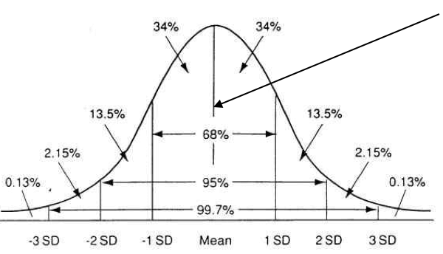
Percentile Ranks

Slide 29
Assessment of Adaptive Behavior
Adaptive behavior refers to the effectiveness or degree to which individuals meet the standards of personal independence and social responsibility expected for age and cultural groups. How they respond to the day-to-day demands of life relevant to someone their age.

Slide 30
Assessment of Adaptive Behavior
Must be conducted when it is suspected that the student may be affected by an Intellectual Disability.
“…a student’s performance falls -1.5 standard deviations from the mean of a test of intellectual ability, existing concurrently with deficits in adaptive behavior.”

Slide 31
Domains of Adaptive Behavior
Communication Skills
Community Use
Self-Direction
Health and Safety
Academic skills
Self-Care
Home Living
Social Skills
Leisure
Work Skills
Maladaptive

Slide 32
Adaptive Behavior Assessments
Scales of Independent Behavior - Revised (SIB-R)
Vineland Adaptive Behavior Scales – II (VABS-II)
Adaptive Behavior Assessment System – II (ABAS-3)
Diagnostic Adaptive Behavior Scale (DABS)
School Function Assessment (SFA)

Slide 33
Considerations
Often inadequately normed
Often inappropriately administered
Poor interrater agreement
  Items difficult to interpret or understand
  Subjective rating criteria
  One or both raters not sufficiently familiar with the individual

Slide 34
Questions We Might Ask…
What is Elwood's overall level of adaptive behavior?
Does Elwood demonstrate any relative strengths within his adaptive behavior profile?
What skills need to be developed in order for Elwood to progress within the adaptive behavior continuum?

Slide 35
Tests of Cognitive Ability
Woodcock-Johnson Tests of Cognitive Ability (WJIV)
Weschler Intelligence scales for Children (WISC-V)
Stanford Binet (SB5)
Universal Nonverbal Intelligence Test (UNIT 2)
Test of Nonverbal Intelligence (TONI)
Comprehensive Test of Nonverbal Intelligence (CTONI)

Slide 36
Considerations
Reliability
Scores provided
Breadth of coverage
Theoretical underpinnings

Slide 37
Questions We Might Ask…
What is Elwood's overall level of cognitive functioning?
Does Elwood demonstrate any relative strengths within his cognitive profile?
What does Elwood’s cognitive profile tell us about potential instructional approaches or strategies?

Slide 38
Tests of Academic Achievement
Woodcock-Johnson Tests of Cognitive Ability (WJIV)
Weschler Induvial Achievement Test (WIAT-III)
Peabody Picture Vocabulary Test
Oral and Written Language Scales (OWLS)
Key Math Diagnostic Test
ProEd family of narrow focused tests (TOWL, TORC, TEMA)

Slide 39
Basic Skills – VT Dept. of Ed Rules & Regulations
(1) Unless otherwise specified in the disability category in these rules, basic skill areas are:
  Oral expression;
  Listening comprehension;
  Written expression;
  Basic reading skills;
  Reading comprehension;
  Mathematics calculation;
  Mathematics reasoning;
  Motor Skills
Achievement Battery vs.
Narrow Focused Test

Slide 40
Considerations
Reliability
Scores provided
Breadth of coverage
Item selection
Cluster/Index/Composite composition
Achievement Battery vs. Narrow Focused

Slide 41
Questions We Might Ask…
Does Elwood demonstrate any relative strengths within the basic skill areas?
What specific skills related to each basic skill area does Elwood possess?
What specific skills need to be developed in order for Elwood to progress within each basic skill area?

Slide 42
Cross Battery Assessment
Utilizes a number of different assessment tools to identify individual strengths
Focuses on individual’s response style
Utilizes reliable and valid measures
Yields specific skill information
Allows for the possibility of two measures for each skill area
Increases potential to adequately respond to the evaluation questions

Slide 43
Cross Battery Assessment
Evaluator becomes familiar with the student’s response capabilities
    Observation
    Interviews
Evaluator selects appropriate assessment tools or portions of tools to respond to evaluation questions
Test administration
Evaluator reports out strengths and challenges and makes recommendations

Slide 44
Curriculum-Based Assessment (CBA)
Items sample skills that have been taught to a specific point in time
Are recursive in nature
Informs instruction and/or need for review

Slide 45
Example of a Curriculum-Based Assessment (CBA)
Instruction
CBA Time 1:
Demonstrate understanding of the communitive property of multiplication
Demonstrate how to multiply three-digit numbers (-)
Instruction
CBA Time 2:
Demonstrate how to multiply three-digit numbers (+)
Demonstrate understanding that division and multiplication are opposite (inverse operations)
Instruction
CBA Time 4:
Demonstrate understanding that division and multiplication are opposite
Demonstrate understanding of decimal notation for money
Add and subtract money values up to $10.00
Demonstrate how to multiply three-digit numbers

Slide 46
Curriculum-Based Measurement (CBM)
Designed to serve as “signs” of general achievement
Are typically fluency measures
Are standardized tests
Are designed to be as short as possible so as not to conflict with teaching.
Describe academic competence at a single point in time
Are sensitive to improvement in short periods of time so quantify the rate at which students develop academic competence over time

Slide 47
Curriculum-Based Measurement (CBM)
Each CBM test is of equivalent difficulty
Measurement is frequent
Assessment data is graphically represented
Students are actively engaged in the process (goal setting, graphing, celebrations)
Assessment information is used to formulate instructional decisions to build more effective programs to increase student achievement

Slide 48
Summarize Data & Examine Results for Individual Students
Instructional Change
Aim Line
Trend Line No. 2
Trend Line No. 1

Slide 49
Reporting Out Evaluation Results
Select an appropriate type of score and use it consistently if possible
If differing types of scores must be used, be sure to clearly explain each type
Focus on strengths
Describe challenges
Avoid jargon… Provide explanations when needed

Slide 50
Reporting Out Evaluation Results
Summarize what we have learned about the student and how we will use that information
Make explicit links between test performance and real-life implications/performance
Be cognizant of your audience

Slide 51
Tests You May Encounter
KeyMath-3 DA (KeyMath-3 Diagnostic Assessment)
KTEA-3 (Kaufman Test of Educational Achievement | Third Edition)
WJ-IV (Woodcock-Johnson Tests of Achievement| Fourth Edition)
OWLS-II (Oral and Written Language Scales | Second Edition)
PPVT-5 (Peabody Picture Vocabulary Test | Fifth Edition)
Sensory Profile 2 (Sensory Profile 2)
TOWL-4 (Test of Written Language | Fourth Edition)
Vineland-3 (Vineland Adaptive Behavior Scales | Third Edition)
WIAT-4 (Wechsler Individual Achievement Test | Fourth Edition)
WISC-V (Wechsler Intelligence Scale for Children | Fifth Edition)
(CASL-2) Comprehensive Assessment of Spoken Language, Second Edition

Slide 52
Other Tests You May Encounter
BEERY VMI (Beery-Buktenica Developmental Test of Visual-Motor Integration | Sixth Edition)
CELF - 5 (Clinical Evaluation of Language Fundamentals | Fourth Edition)
CTONI-2 (Comprehensive Test of Nonverbal Intelligence | Second Edition)
CTOPP-2 (Comprehensive Test of Phonological Processing | Second Edition)
EVT-3 (Expressive Vocabulary Test | Third Edition)
GORT-5 (Gray Oral Reading Test | Fifth Edition)
KABC-II NU (Kaufman Assessment Battery for Children | Second Edition Normative Update)
WJ-IV (Woodcock-Johnson Tests of Cognitive Abilities| Fourth Edition)

