Slide 1
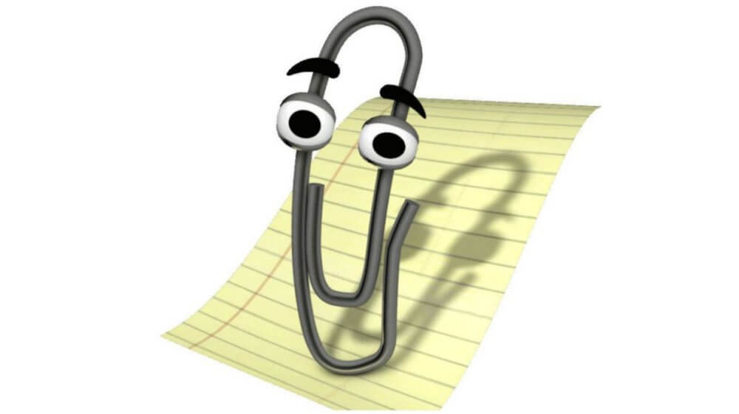
Accessible Word Documents
go.uvm.edu/accessibility
Audrey Homan | choman@uvm.edu

Slide 2
Contents:
go.uvm.edu/accessibility
What Word Can (And Cannot) Do
Automated Testing
Manual Testing
Advanced Accessible Word Features (That We’re Not Covering Today)

Slide 3
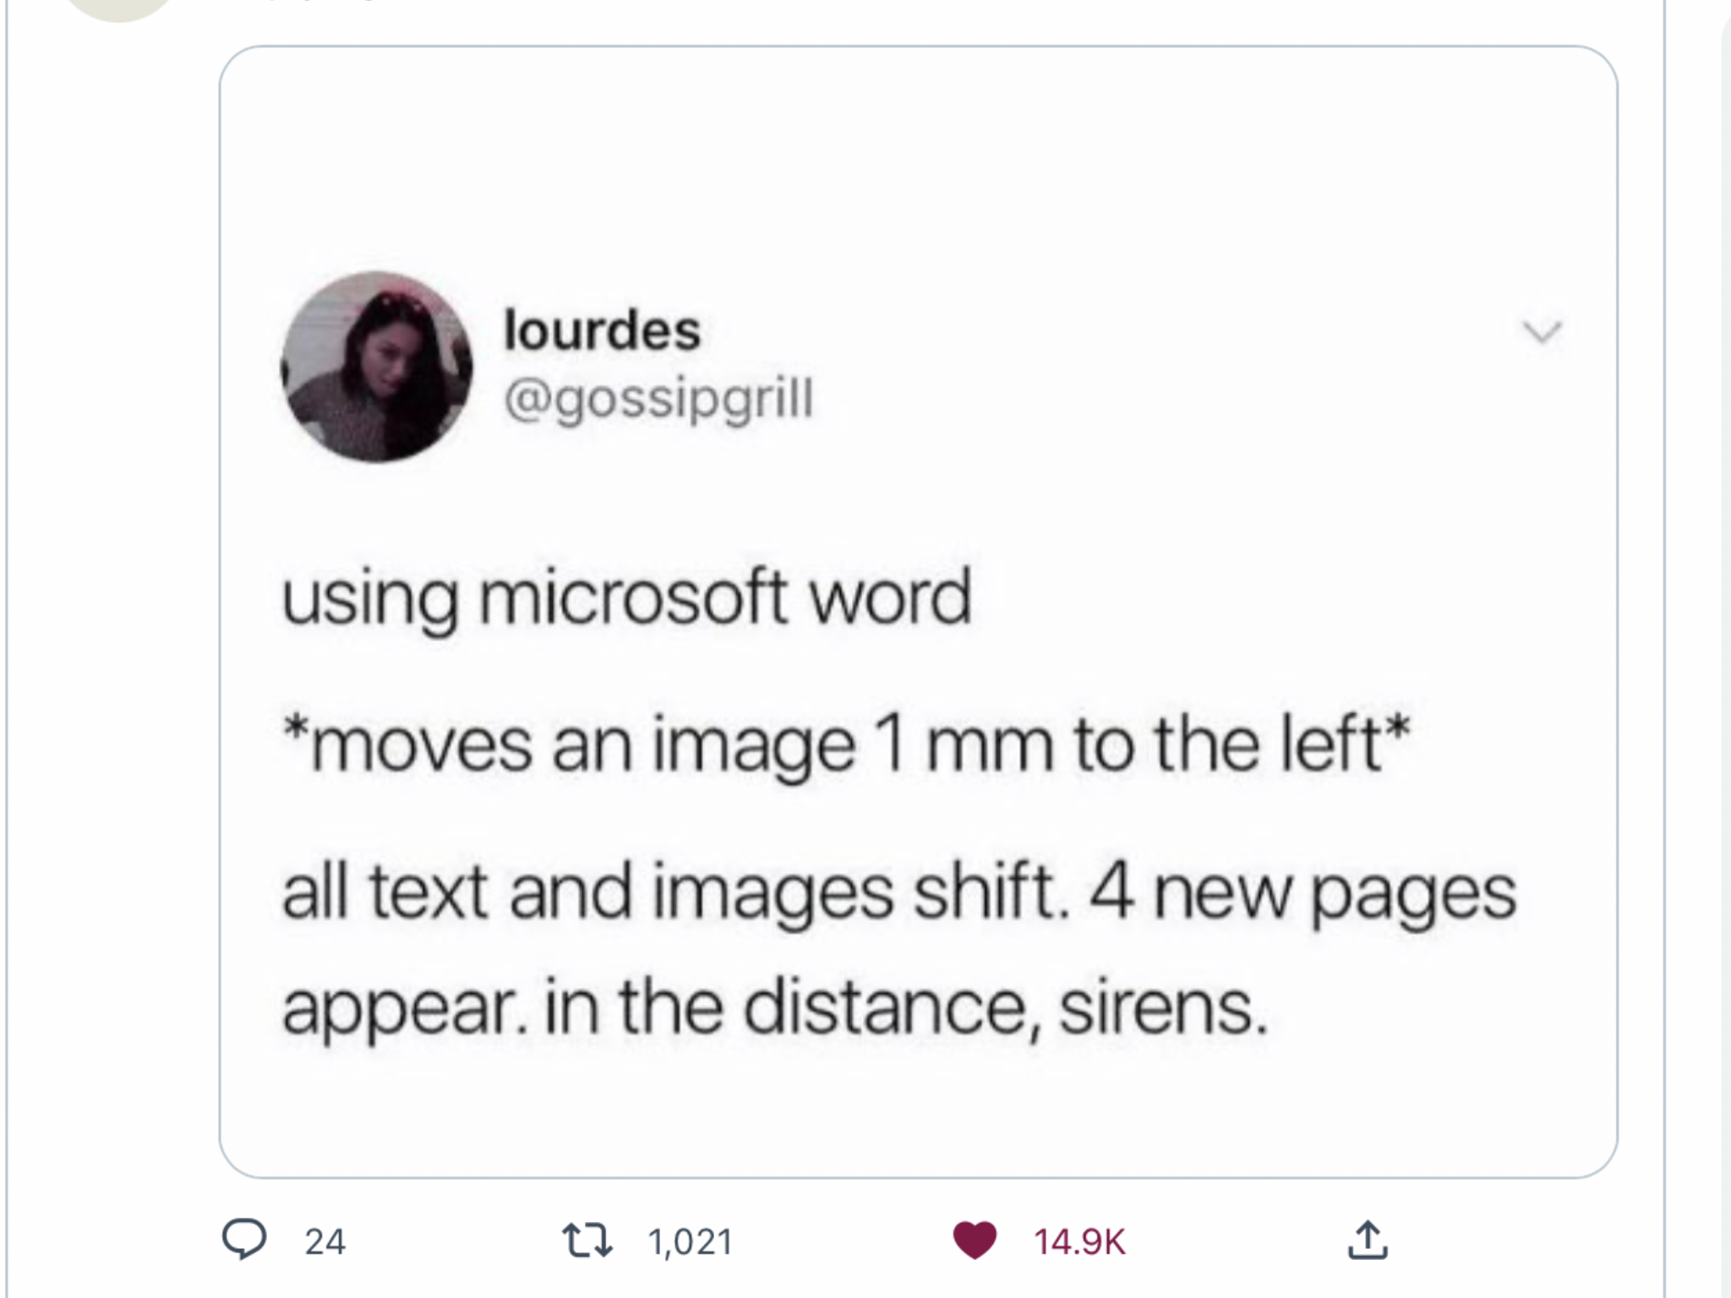
WHY WORD? WHYYYYY

Slide 4
WHAT WORD CAN (AND CANNOT) DO
Microsoft Word is great for creating and delivering text documents.
It is not a graphic design tool.

Slide 5
AUTOMATED + MANUAL TESTING
AUTOMATED | MANUAL
Alt-text In-line images Headings Specify Language | Font size, family, and style Text alignment Color contrast Links format Readable file name Updated Properties data

Slide 6
WORD ACCESSIBILITY @ CDCI
AUTOMATED | MANUAL
Alt-text In-line images Headings Specify Language | Font size, family, and style Text alignment Color contrast Links format Readable file name Updated Properties data
Addressing these items should* get you to the level of accessibility for Word documents that CDCI is requesting.

Slide 7
THE ASTERISK
AUTOMATED | MANUAL
Alt-text In-line images Headings Specify Language | Font size, family, and style Text alignment Color contrast Links format Readable file name Updated Properties data
*As always, ask for and respond to user feedback on the accessibility of your documents.

Slide 8
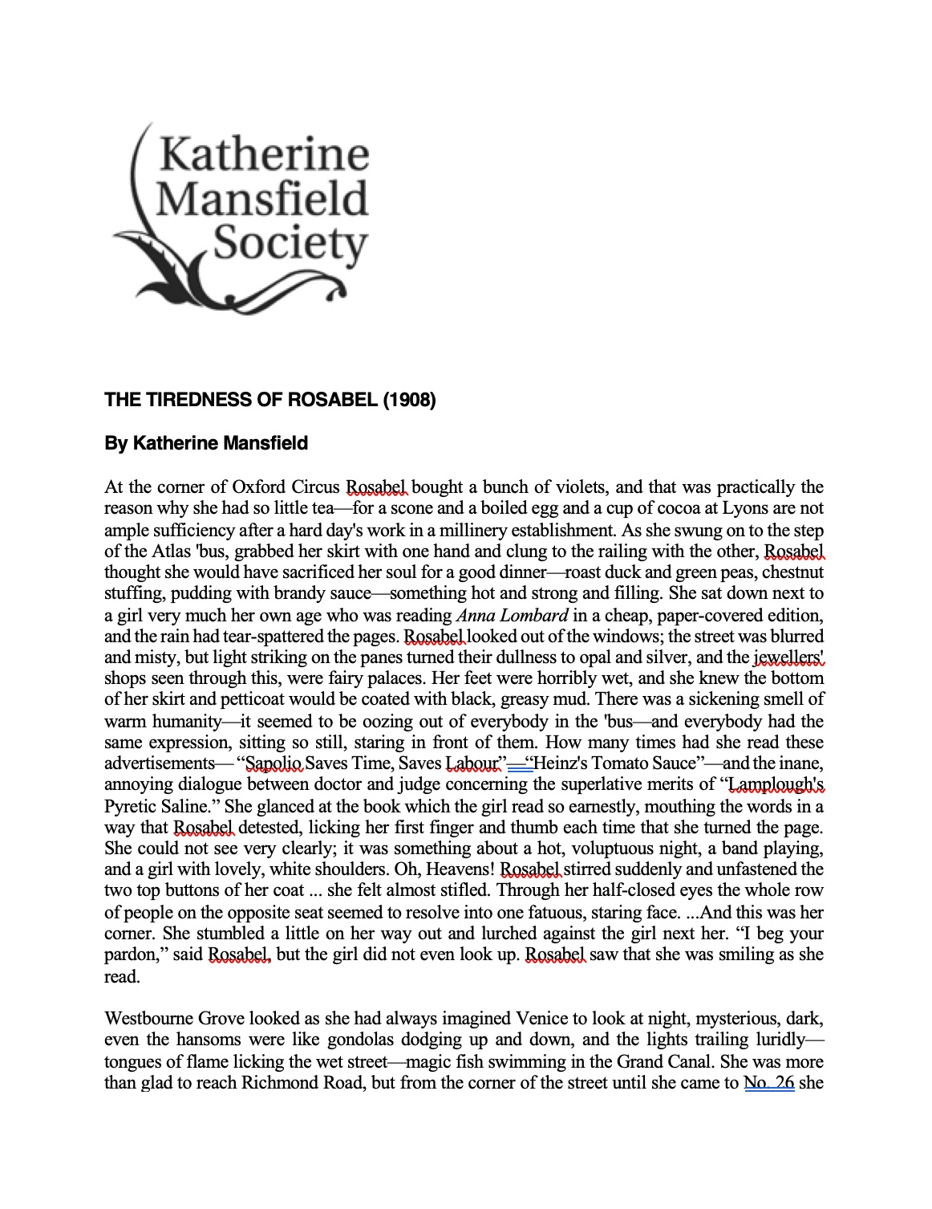
THE TIREDNESS OF ROSABEL
Here’s a sample Word document for you to work through.
It has many accessibility issues, and we’re going to go through how to fix those.

Slide 9
WORD HAS AN AUTOMATED ACCESSIBILITY CHECKER
Word has an automated Accessibility Checker.
AUTOMATED | MANUAL
 | Font size, family, and style Text alignment Color contrast Links format Readable file name Updated Properties data

Slide 10
HOW TO TURN ON THE ACCESSIBILITY CHECKER
In Microsoft Word, select View > Sidebar > Reviewing. Then choose Review > Check Accessibility.
In OneNote, select View > Check Accessibility.

Slide 11
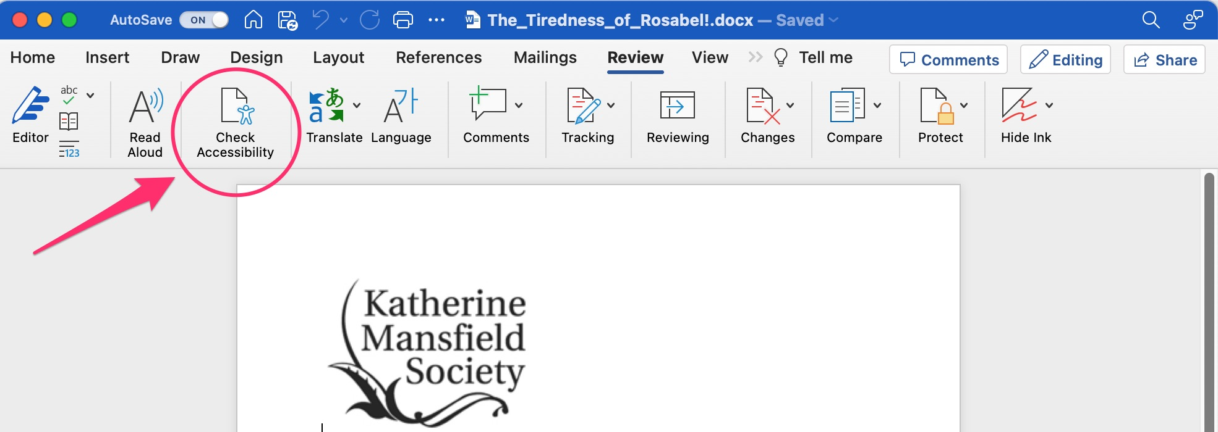
WHY CAN’T I FIND THE ACCESSIBILITY CHECKER
Widen your window to make sure you see Reviewing in your top ribbon.

Slide 12
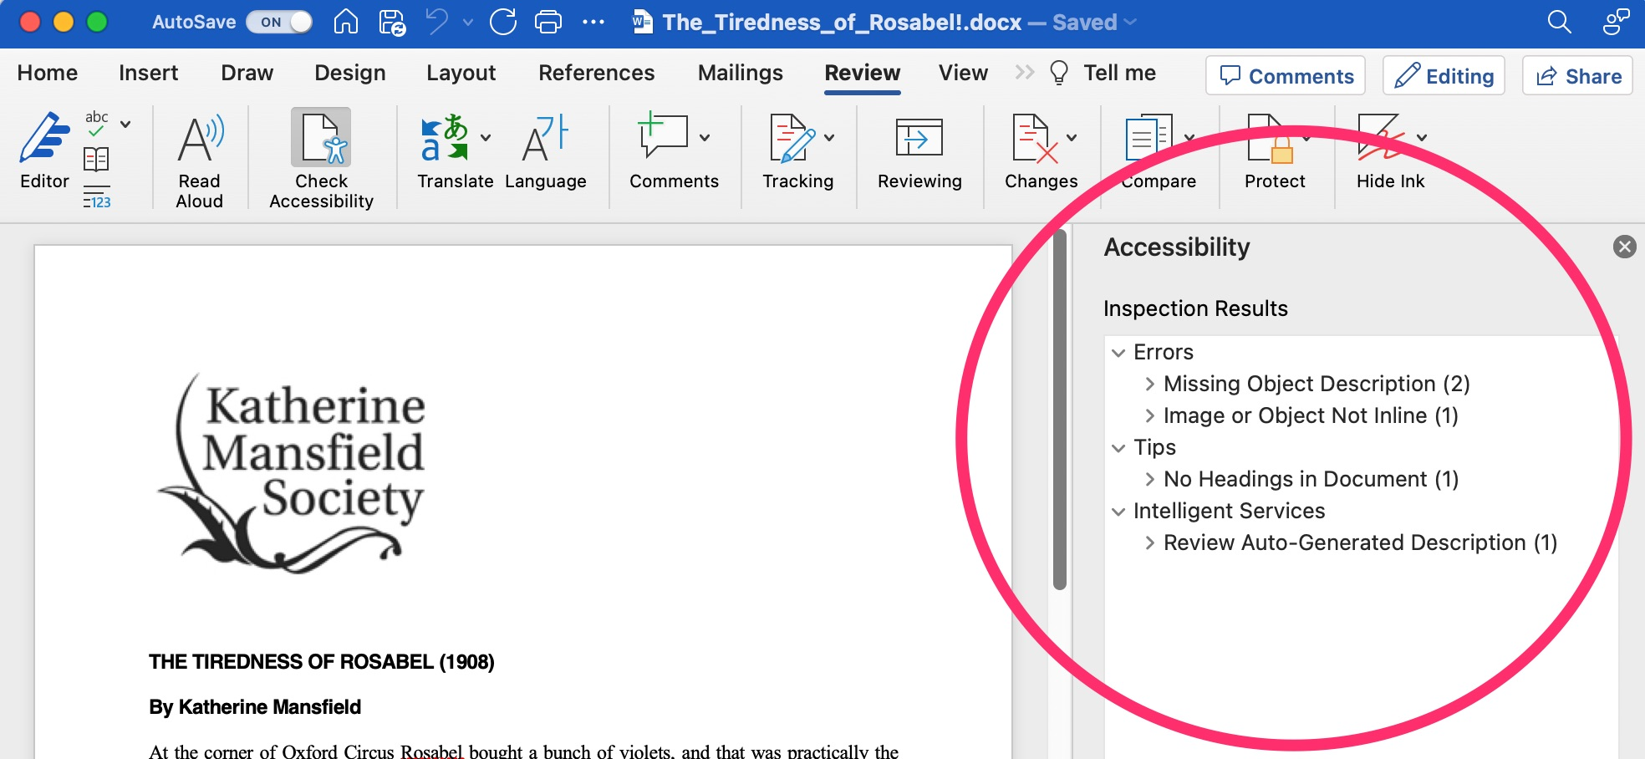
What the accessibility Checker Should Look Like

Slide 13
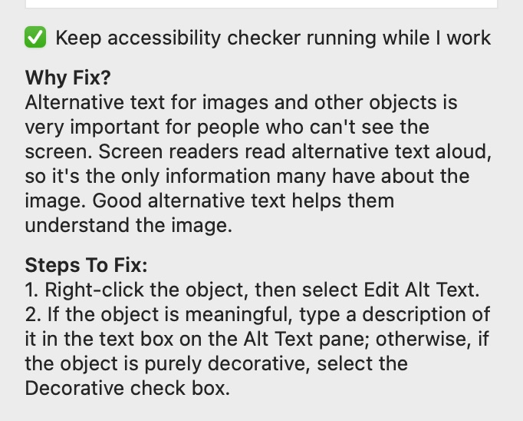
ACCESSIBILITY CHECKER : ALT-TEXT
“Missing Object Description” = no alt-text on an image.

Slide 14
DECORATIVE OBJECTS
Decorative objects are items that do not contain meaning necessary to understand the document, such as arrows, starbursts, and lines.
This also includes decorative elements between chunks of text.

Slide 15
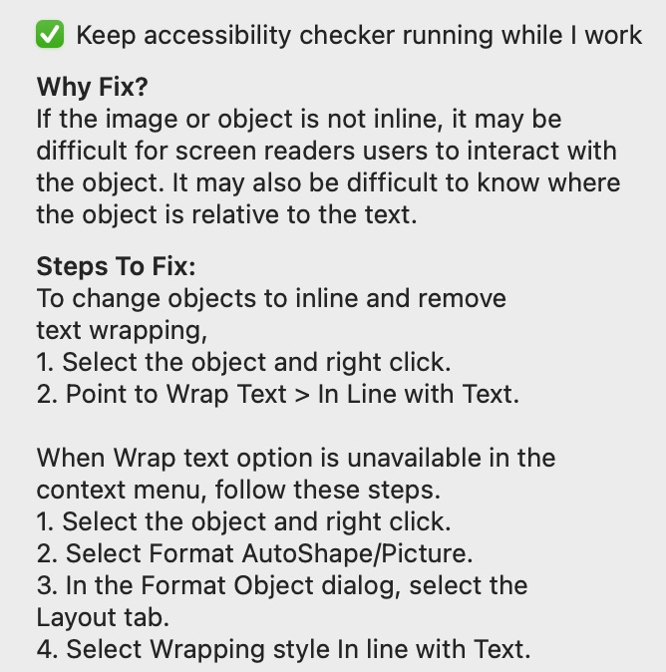
ACCESSIBILITY CHECKER : IN-LINE IMAGES
“Image or Object Not Inline” = image or object needs to be aligned with the text.

Slide 16
ACCESSIBILITY CHECKER : HEADINGS
“No Headings in Document” = There are no headings in your document.

Slide 17
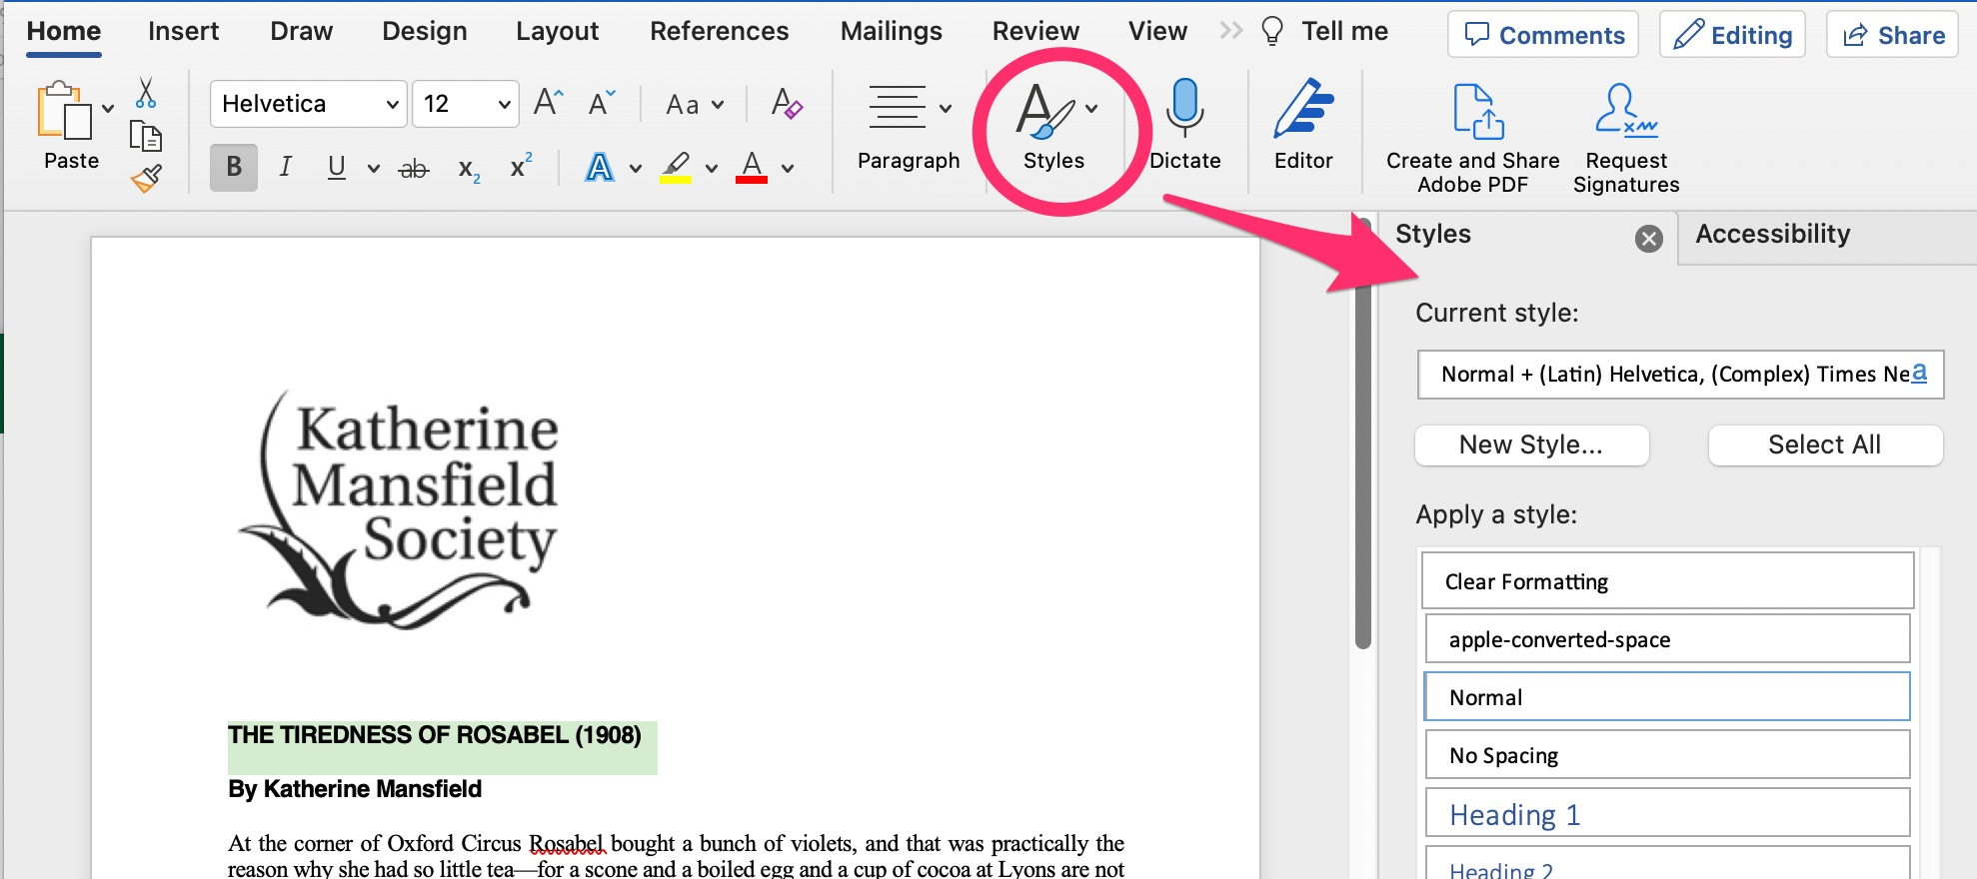
HOW TO ADD HEADINGS TO YOUR DOCUMENT
Open up the Styles Pane in Word.
It should be on the Home ribbon.

Slide 18
START WITH THE TITLE
Your title should be Heading 1. Your subtitle should be Heading 2. And so on.

Slide 19
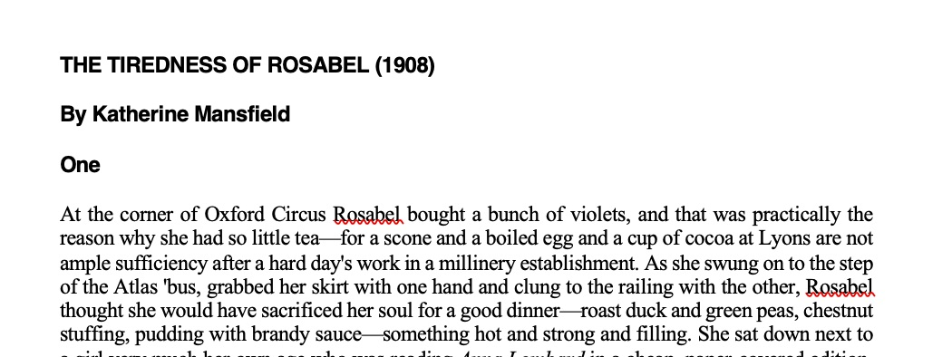
BUILD AN OUTLINE
You’re using Headings to create an outline of your document.
Heading 1
Heading 2
Heading 3
Normal

Slide 20
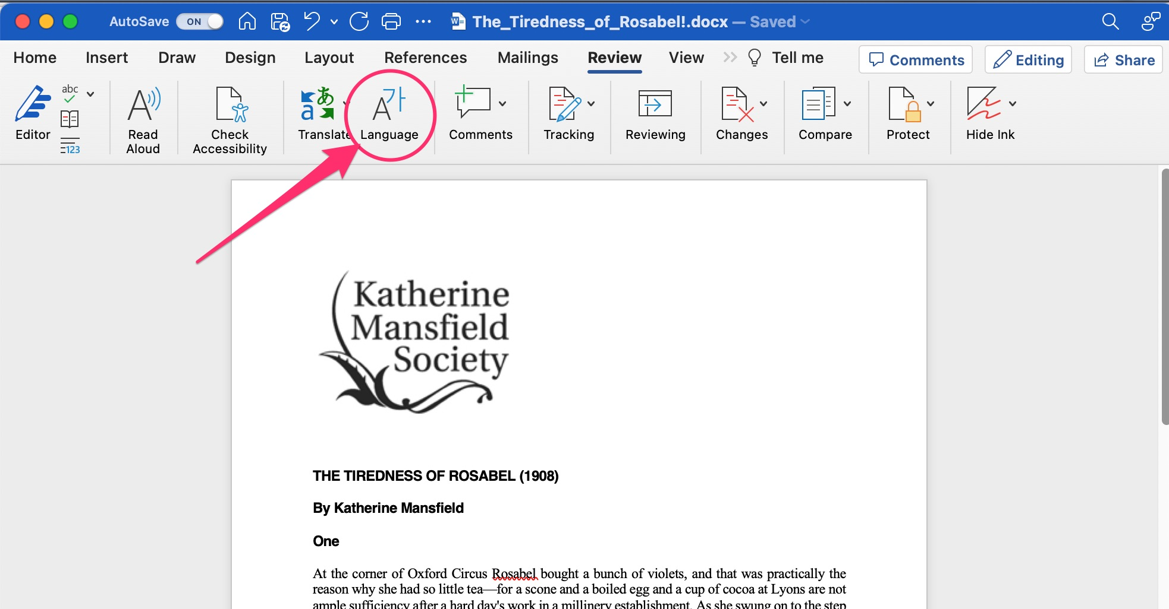
AUTOMATED TESTING: SPECIFY A LANGUAGE
Go to the Review ribbon, and choose Language.

Slide 21
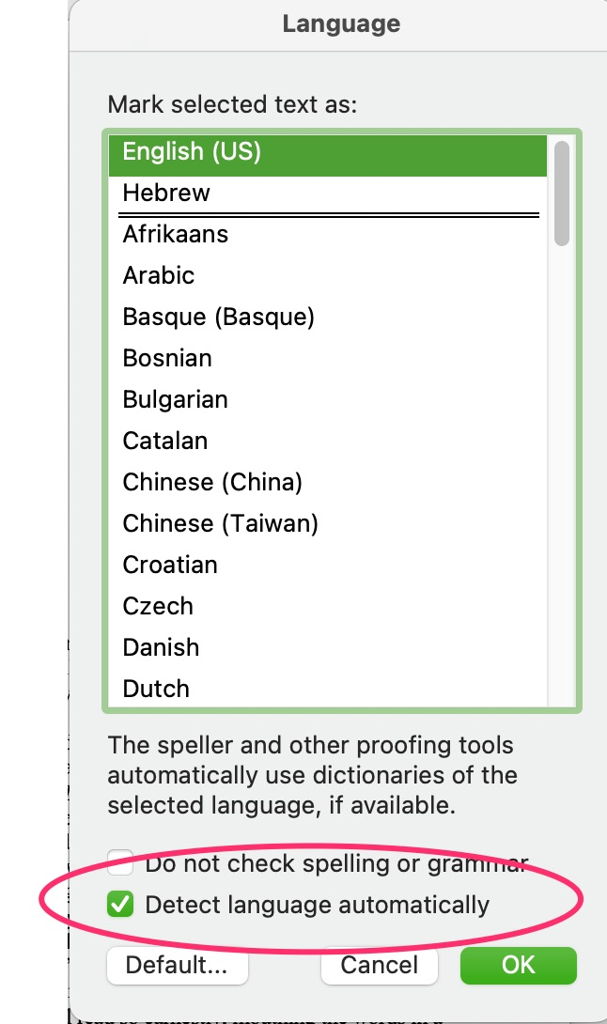
AUTOMATED TESTING: CHECK YOUR LANGUAGE
Word should automatically detect the language of your document, but just doublecheck.

Slide 22
MANUAL ACCESSIBILITY TESTING
AUTOMATED | MANUAL
 | Font size, family, and style Text alignment Color contrast Links format Readable file name Updated Properties data
You also need to do some manual accessibility testing.

Slide 23
MANUAL TESTING: FONT SIZE, FAMILY, AND STYLE
Check your minimum font size on the body text and headings.
Choose a readable font family for the type and length of text you’re working with.
Think about how much of your text is italicized, bolded, or in ALL CAPS — and why.

Slide 24
MANUAL TESTING: TEXT ALIGNMENT
Left-justify your text. If you choose to justify text on both sides, have a good reason for it, or better yet, test its readability with some users.

Slide 25
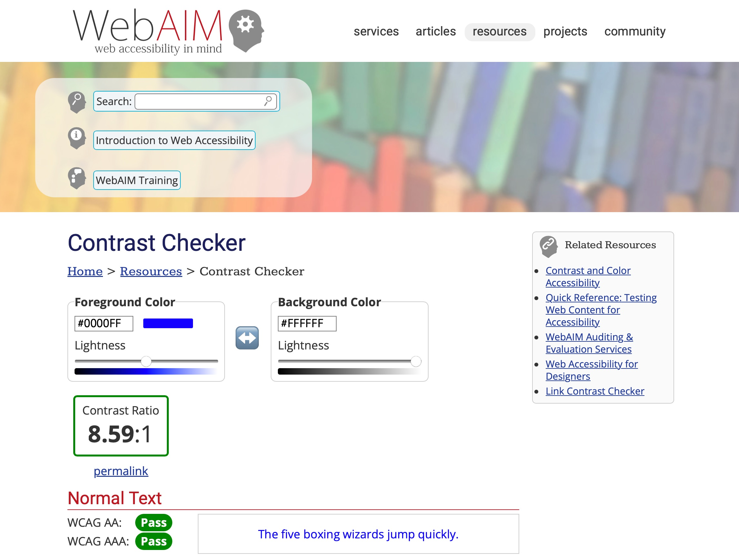
MANUAL TESTING: COLOR CONTRAST
Check your color contrast throughout the document:
small text: 4.5: 1
large text: 3:1
icons and graphics: 3:1

Slide 26
MANUAL TESTING: ACCESSIBLE FILE NAMES
Don’t start or end your filename with a space, period, special character or underline.
Keep your filenames to a reasonable length.
Use lowercase or Camel Case.

Slide 27
MANUAL TESTING: MORE TIPS FOR ACCESSIBLE FILE NAMES
To be accessible to screen readers, file names should not contain spaces and/or special characters.
Don’t use spaces and underscores; use hyphens instead.

Slide 28
OH, ROSABEL.
Rosabel’s current file name: THE_TIREDNESS_OF_ROSABEL!.docx
What would you change to make the filename accessible?

Slide 29
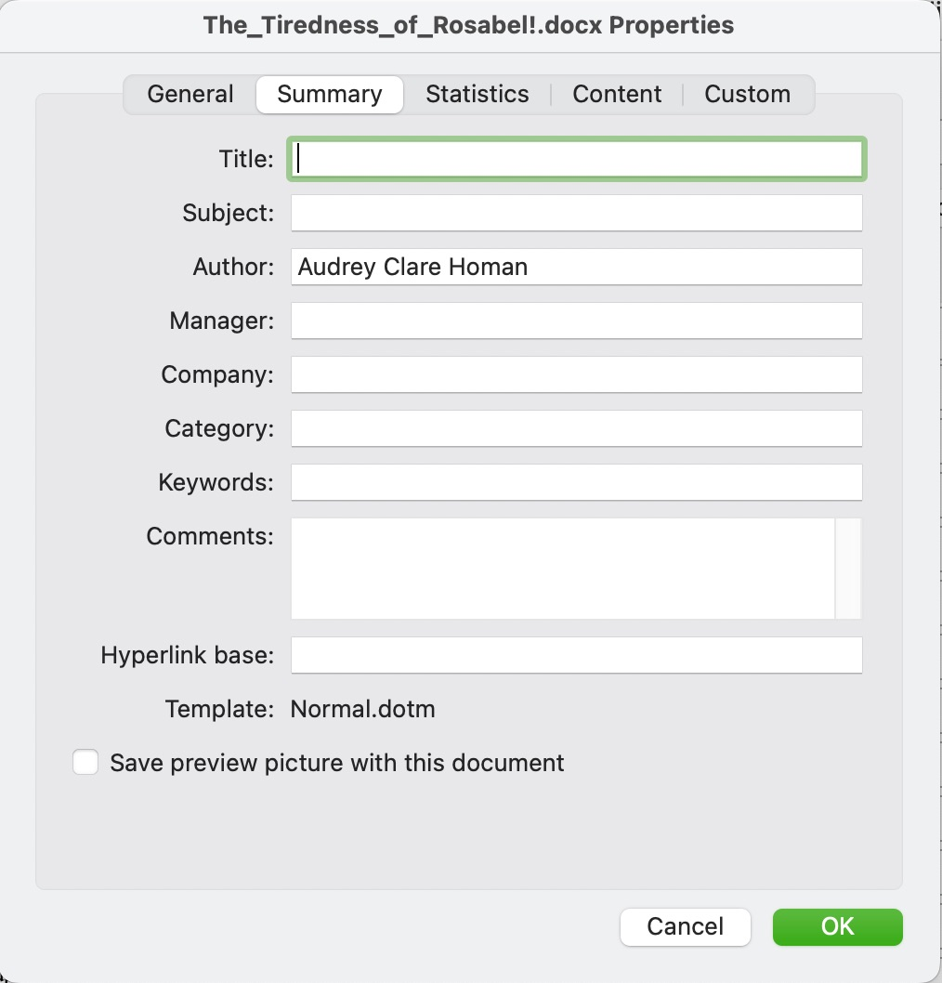
MANUAL TESTING: PROPERTIES
Open up the Properties window: File > Properties…
and go to the Summary tab.

Slide 30
MANUAL TESTING: PROPERTIES: WHICH FIELDS TO FILL
Fill in:
Title
Author
Manager

Slide 31
MANUAL TESTING: PROPERTIES: HOW TO FILL THE FIELDS
Fill in:
Title: Document Title
Author: Project or Organization Name
Manager: Your Name

Slide 32
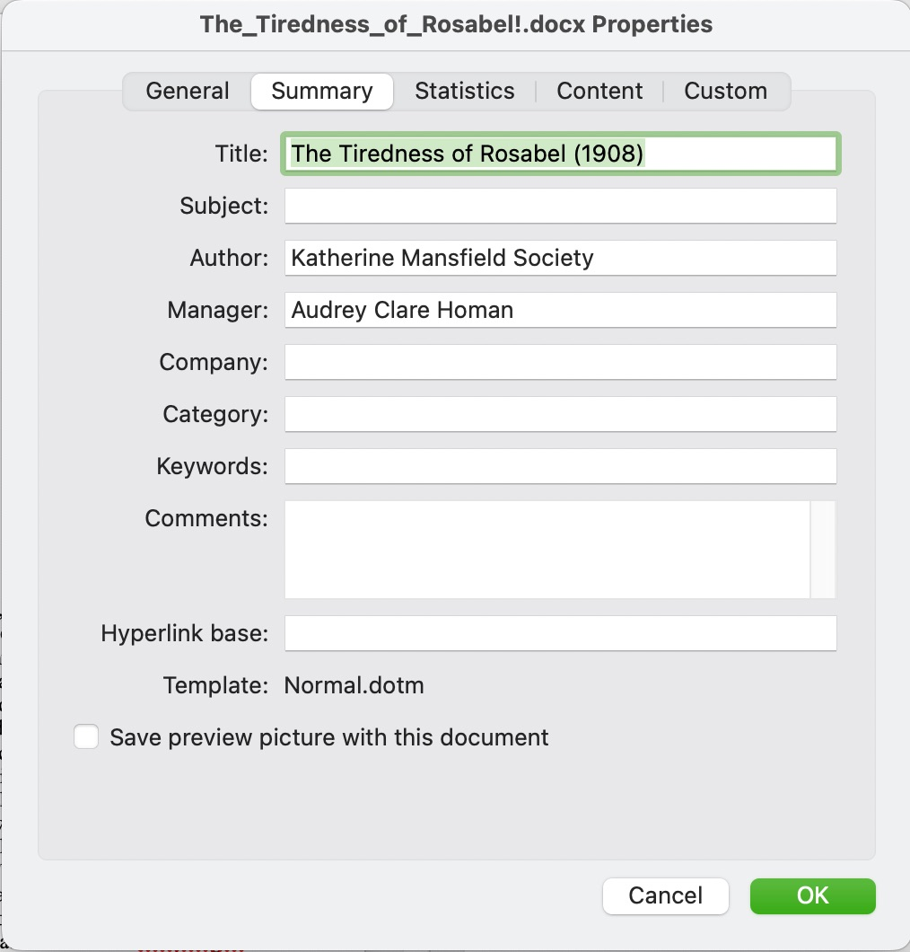
MANUAL TESTING: PROPERTIES: WHAT FIELDS?

Slide 33
THE FULL LIST OF THINGS TO FIX IN ROSABEL
AUTOMATED | MANUAL
Add alt-text for both photos Make the images in-line with the text Add heading styles to the text Language set automatically | Double-check the color-contrast of the orange line at the bottom Make sure the body font is at least 14pts Fix the file name Add Properties data Links need to be underlined Left-justify the text

Slide 34
ADVANCED WORD ACCESSIBILITY FEATURES
You will need to do additional accessibility work
if your Word document includes:
Tables
Bulleted Lists
Columns
Sections

Slide 35
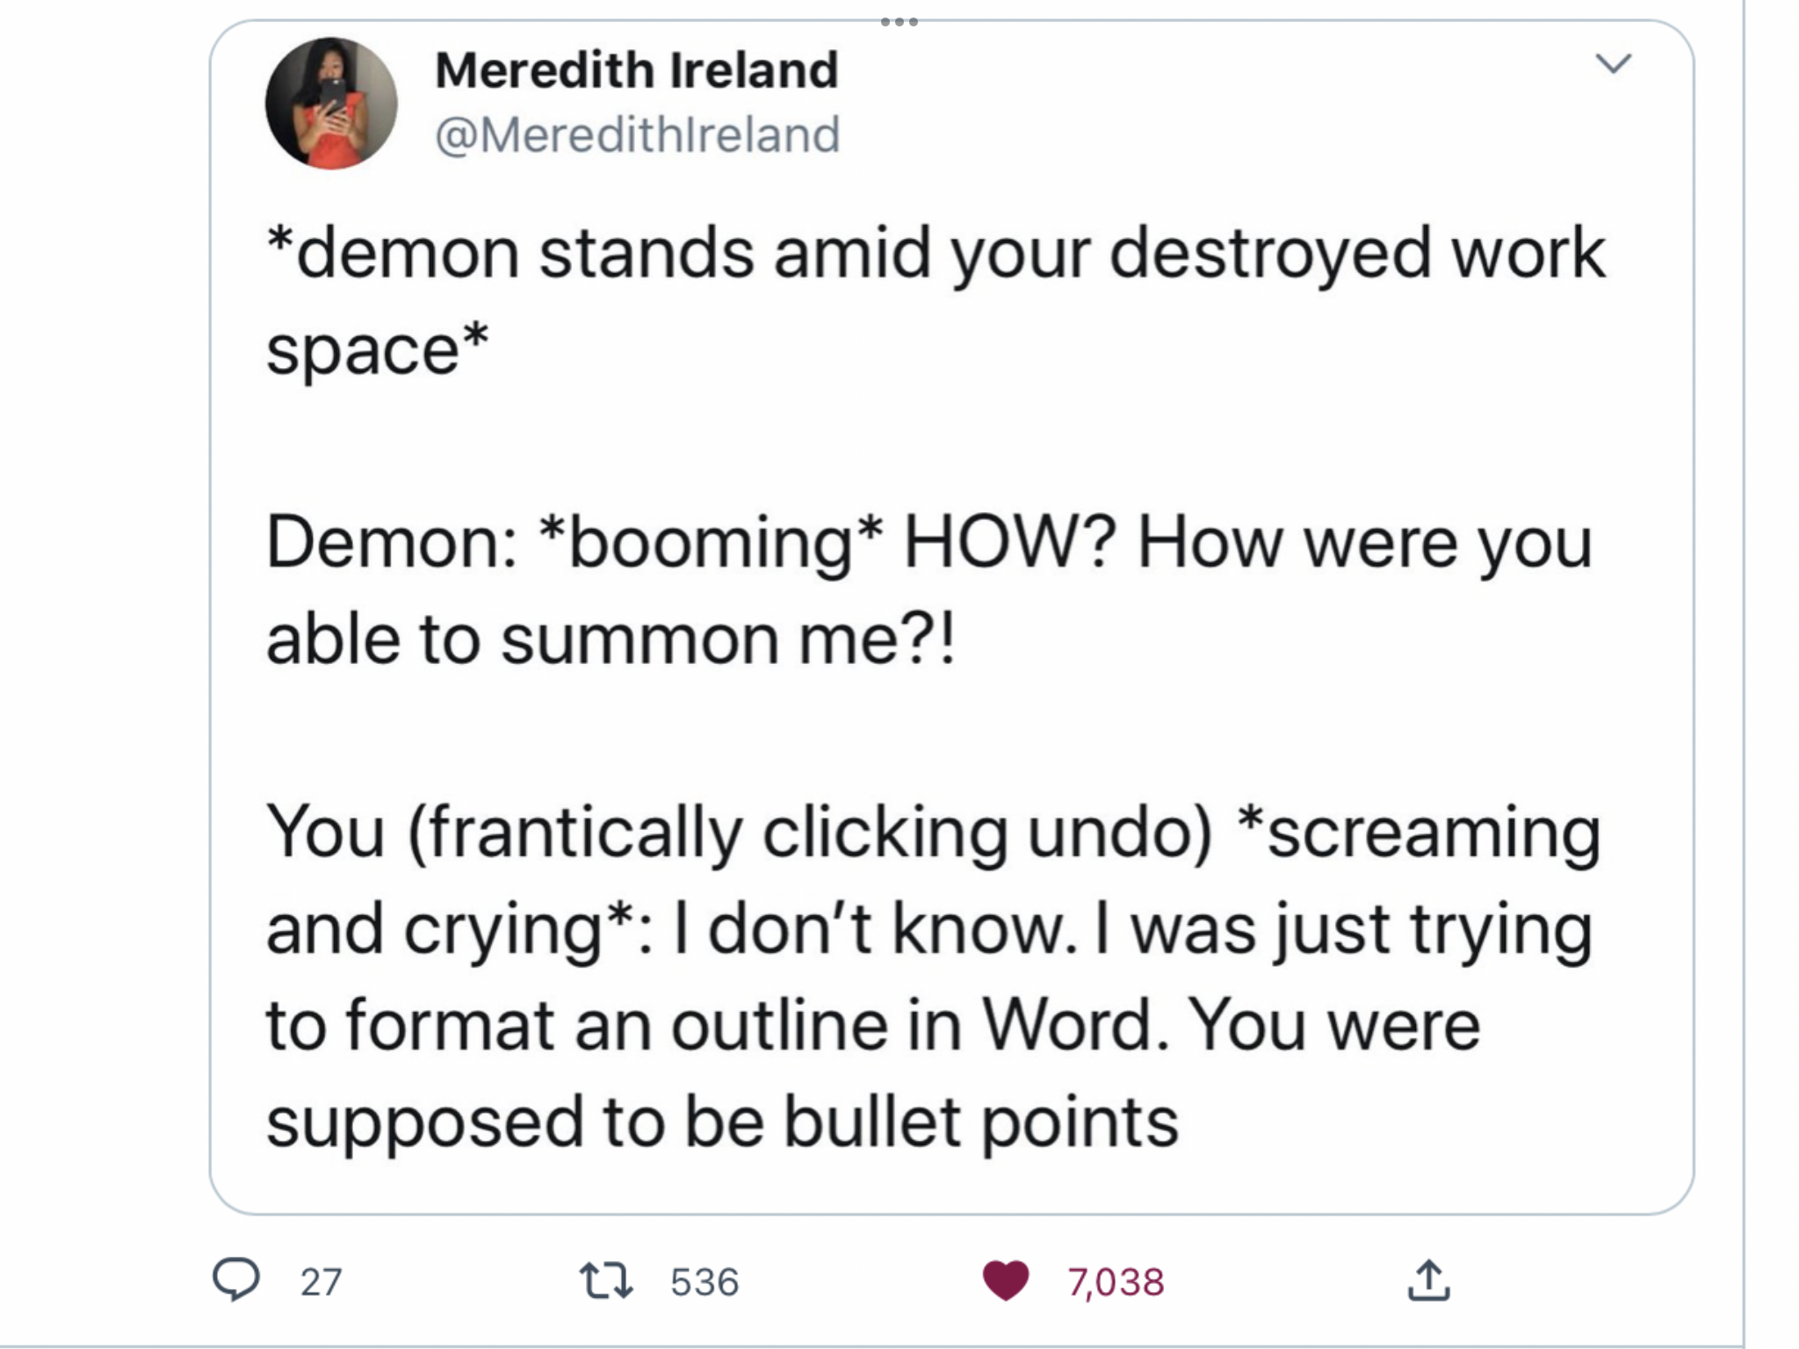
ESPECIALLY BULLETED LISTS.

Slide 36
FOUR FOR THE ROAD:
Resist the freakout. This is a lot to train yourself to do. Pick one thing from today’s workshop and try it for 30 days.
Accessibility is a continuum. We are all doing our best. And we can all do better.
Ask for help. This is all our jobs, and we’re all learning.
Trust human data over automation.

Slide 37
REFERENCES
ACCESSIBLE FILE NAMES: Please…No Spaces and/or Special Characters
Characters to Avoid in File Names and Directories
About Decorative Images
WebAIM Contrast Checker
Colorblind WebPage Filter

Slide 38
Thank you for your time.
go.uvm.edu/accessibility
Feel free to use it and remix it for non-commercial use, with attribution.
This presentation is licensed under CC-BY-NC-SA.

